Slide 1
For Loops and Java
Alise, Adam, Tanya, Christopher
Notes:
We are assuming that students have an understanding of while loops

Slide 2
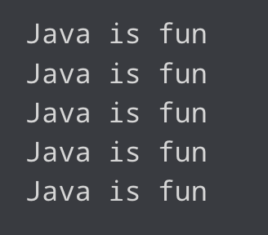

Do Now (5 min)
With your table discuss how to get Java to output this.
Hint...How do we print to the console in java?
Notes:
Assuming students remember how to print.
Ask for student share outs. Chart or record on a poster.

Slide 4
Learning Targets
I can describe the purpose of each part of a for loop.
Initialization
Check the exit condition
Increment
I can create a for loop to make my code more efficient.

Slide 5
Hook
Jump 2 times
Wait 1 seconds
Jump 2 times
Wait 1 seconds
Jump 2 times
Wait 1 seconds
Jump 2 times
Wait 1 seconds
Jump 2 Times
Wait 1 seconds

Slide 6
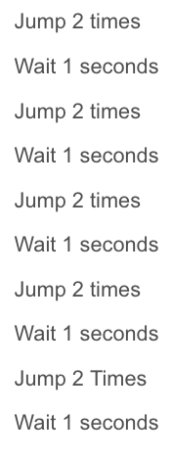
Turn and Talk
How many times did you jump in total?
Which instructions get repeated?
Can you come up with an optimized way to give the same instructions?

Slide 7
D
R
Y

Slide 8
Don’t
Repeat
Yourself

Slide 9
In Java
Say I wanted to print *

Slide 10
Direct/Guided Instruction
for(int counter = 0; counter < 5; count++){
System.out.println(“Java is fun”);
}
int counter = 0; ( Initialize a variable)
counter < 5; (Check the exit condition)
Count++ (Increment)

